Slide 1
Software AIPEX PRO
  Installation

Slide 2
PC Requirement
Supported operation systems
Windows 10
Windows 8 and 8.1
Windows 7
Windows XP with SP3 (SP1 must be installed before SP3 become installed)
Recommended PC requirement
Processor: Pentium V, Centrino > 3,0 GHz, Pentium M > 1,5 GHz
Available hard disc space 1 GB or higher
RAM 1024 MB or higher

Slide 3



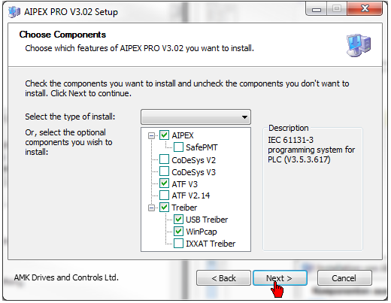
Required Components (FSE)
+
If you use a usb - ethernet adapter
First plug in the adapter, then install AIPEX PRO
AIPEX
Device configuration
Parametrization
Commissioning support
Diagnostic
ATF – Softwareflasher (optional)
Softwareupdate
Driver
USB (direct connection PC - inverter via USB)
WinPcap (direct connection PC - inverter via EtherCAT)
Required
components

Slide 4
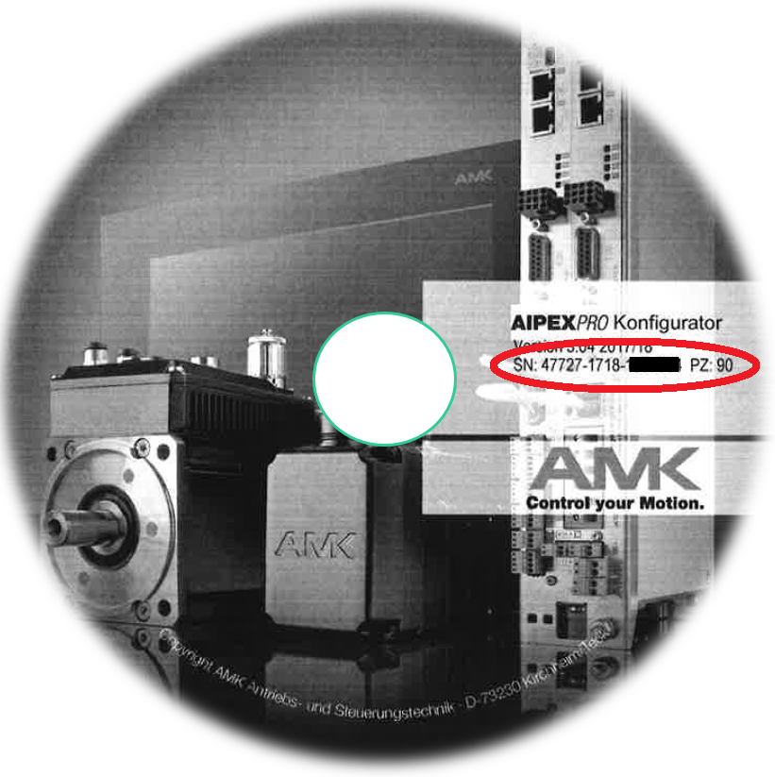

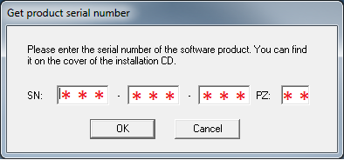
AIPEX PRO Serial Number
You can find the serial number
on the cover of the installation CD.

